Slide 1
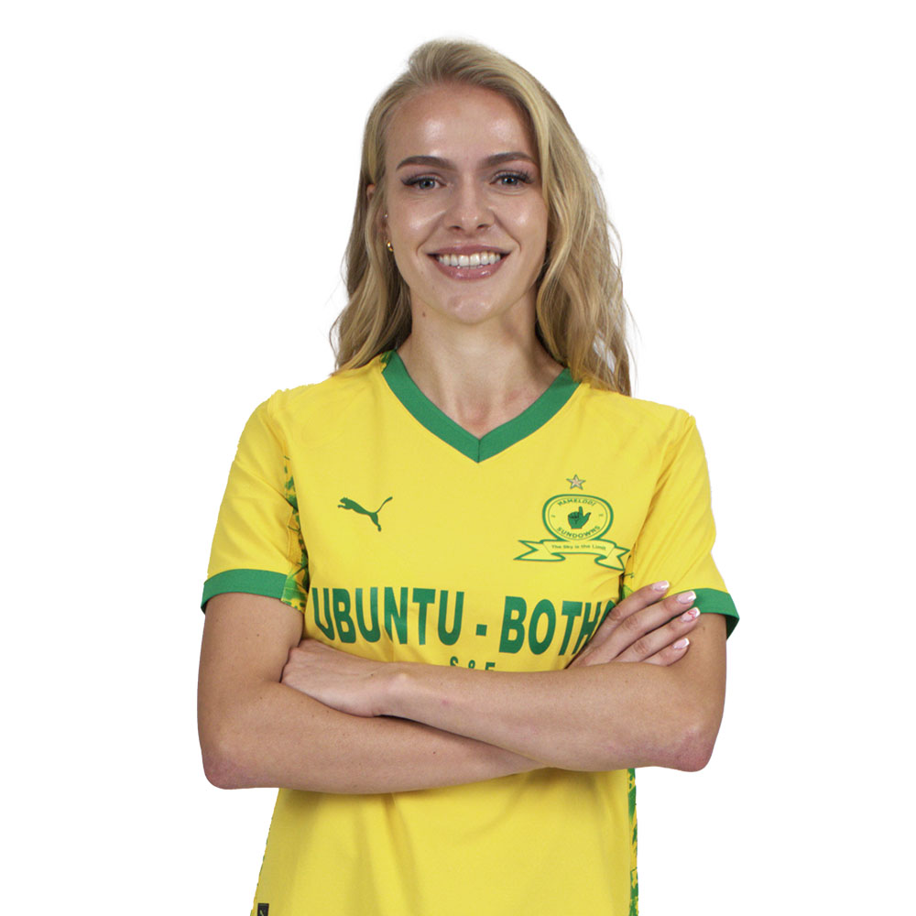
ISABELLA
LUDWIG
Player Report by
Mukiebe Maryann
mukiebemaryann08@gmail.com

Slide 2
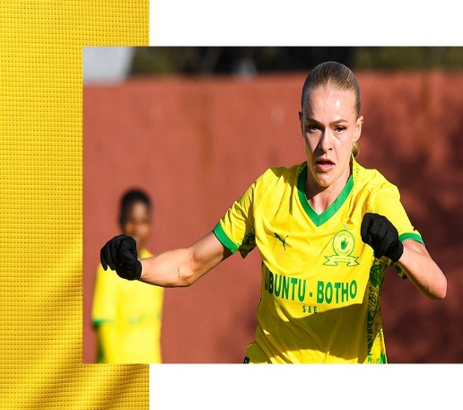
EXECUTIVE SUMMARY
Isabella Alexa Ludwig is a South African midfielder who has risen through the domestic game to establish herself at both club and international level. She developed her early career at Tuks Ladies and was instrumental in the team that finished runners-up at the 2022 Sasol League National Championship. In April 2025, Ludwig moved to Mamelodi Sundowns Ladies and made an immediate impact by scoring on her debut in a 2–0 victory over UCT Ladies.
Internationally, she earned recognition with the South Africa women’s national team, making her senior debut against Namibia on 22 October 2024. She was part of the national squad that competed at the 2024 COSAFA Women’s Championship, further consolidating her status as a player with long-term potential.
Player Name: Isabella Ludwig
Age: 23 years
Nationality: South African
Club: Mamelodi Sundowns Ladies FC
Primary Position: Midfielder
Height: 1.69m
Preferred Foot: Not specified
Contract Status: Joined 2025
2026-01-02
STRENGTHS
WEAKNESSES
High game intelligence and spatial awareness
High work rate and early match impact
Reliable defensive contribution and team cover
Good speed, balance, and overall athleticism
Strong duel-winning ability
Excellent off-the-ball movement and positioning
Comfortable ball shielding and ball carrying
Reliable defensive contribution and team cover
Strong communication and team-first mentality
Occasional mispasses
Ball security issues in tight or unusual situations
Decision-making under heavy pressure can improve

Slide 3
TECHNICAL EVALUATION
PHYSICAL EVALUATION
Comfortable shielding the ball and confident when in possession, retaining control under pressure.
Moves into attacking areas swiftly, with good timing when arriving in the box and awareness of space.
Consistently winning duels, strong defensive technique, recovers possession easily, and effective in midfield defensive phases.
High stamina and work rate, maintaining activity and intensity throughout the match.
She has good speed and strong agility, enabling effective movement across midfield areas.
Physically strong and competitive in duels, uses her body orientation well to protect the ball.
Player Name: Isabella Ludwig
Age: 23 years
Nationality: South African
Club: Mamelodi Sundowns Ladies FC
Primary Position: Midfielder
Height: 1.69m
Preferred Foot: Not specified
Contract Status: Joined 2025
2026-01-02
INTELLIGENCE EVALUATION
PSYCHOLOGICAL EVALUATION
Adapts well between central and advanced roles, contributing both in build-up and recovery phases.
Executes the central midfield role effectively, maintaining structure and balance within the team shape.
Displays a proactive and competitive mentality, as she engages in both offensive and defensive phases.
She is tactically aware, and highly coachable. Emotionally composed as she maintains discipline in high-pressure situations.
Communicates effectively on the pitch.

Slide 4
OFFENSIVE CONTRIBUTION
Intelligent Movement into Attacking Spaces: Well-timed forwards runs, arrives in the box and advanced areas at the right time, supporting attacks and creates goal-scoring chances.
Awareness in the Final Third: Demonstrates understanding of space, recognizing gaps between lines and positioning herself to receive or recycle the ball effectively.
Ball Progression and Support in Build-Up: Confident ball carrier who progresses play through midfield, offering passing options and maintaining possession continuity during build-up phases.
Player Name: Isabella Ludwig
Age: 23 years
Nationality: South African
Club: Mamelodi Sundowns Ladies FC
Primary Position: Midfielder
Height: 1.69m
Preferred Foot: Not specified
Contract Status: Joined 2025
2026-01-02
DEFENSIVE CONTRIBUTION
Positional Discipline and Team Cover: Maintains strong defensive positioning, covering her teammates and protecting central spaces during defensive phases.
Duel-Winning and Physical Presence: Very competitive in physical contests, using balance and strength to disrupt opposition play and win duels in all pitch areas.
Defensive Recovery and Pressing: Reacts fast after losing possession, follows the ball, and applies pressure limiting opposition transitions.

Slide 5
ESTIMATED RATINGS ACROSS KEY PERFORMANCE AREAS
Player Name: Isabella Ludwig
Age: 23 years
Nationality: South African
Club: Mamelodi Sundowns Ladies FC
Primary Position: Midfielder
Height: 1.69m
Preferred Foot: Not specified
Contract Status: Joined 2025
2026-01-02

Slide 6
PRIMARY ROLE
Isabella Ludwig operates as a central midfielder with box-to-box responsibilities. A key figure in offensive and defensive phases. Her role involves supporting build-up play, maintaining positional balance, supporting build-up play, and providing defensive cover through recovery runs and duel-winning in midfield.
Player Name: Isabella Ludwig
Age: 23 years
Nationality: South African
Club: Mamelodi Sundowns Ladies FC
Primary Position: Midfielder
Height: 1.69m
Preferred Foot: Not specified
Contract Status: Joined 2025
2026-01-02
SUMMARY
Isabella Ludwig is a physically strong and tactically intelligent midfielder who brings energy, structure, and balance to the team. She supports attack, reads the game well, contributes consistently off-the-ball. She is defensively reliable and offensively aware, and is well-suited to systems that require midfielders to connect play and cover ground.

